Slide 1
Water Reminder Application
Human-Computer Interaction FISAC Presentation
By
G10
Suhas Srinivas Gowda(200953014)
Adithya Rao Kalathur(200953015)
Vaishnavi(200953025)
Computer & Communication Engineering
Department of Information & Communication Technology
MIT, Manipal

Slide 2

Presentation Outline
Introduction
Interface Design
User Support
Additional implementations/concepts used
Screenshots of the Application
Evaluation Process
Type of Users
Individual Contribution

Slide 3
Introduction
A water reminder app is a mobile application designed to help users establish and maintain healthy hydration habits by tracking and encouraging the consumption of an adequate amount of water daily.
This App offer a variety of features and functionalities to assist users in staying properly hydrated, which is essential for overall well-being and health.
The water reminder app lets users customize daily intake goals based on factors like age, weight, and activity level, with the option to choose preferred measurement units.
The app sends customizable reminders and notifications throughout the day, allowing users to set the frequency, timing, and type based on their preferences, whether gentle nudges or more urgent alerts.

Slide 4
Introduction(Continued)
Users can log water intake in the app, maintaining a record that aids in tracking progress toward daily hydration goals. Visual representations like charts and progress bars offer a clear overview of daily consumption patterns, helping users gauge their proximity to goals.
In summary, a water reminder app is a comprehensive tool promoting proper hydration through customization, education, gamification, device integration, and community engagement, aiming to make staying hydrated beneficial, engaging, and enjoyable for users.
The Sustainable Development Goal that we have chosen for our project is SDG 6 which is “Clean water and Sanitation”.
The main Goal of this SDG is to “Promote Daily Hydration for Health and Well-Being”.
Some other SDG’s that we have followed are SDG3( Good Health and Well-Being),SDG4(Quality Education) and SDG9(Industry, Inovation and Infrastructure).

Slide 5
Interface Design
To make this Application we have applied Ben Shneiderman's "Eight Golden Rules of Interface Design“ which provides valuable guidelines for designing user-friendly and effective interfaces.
The Eight Golden Rules that we applied in our project are-
Strive for Consistency:The size of the text is same in all the pages and the text size and the contrast is same in all the pages.
Permit Easy Reversal of Actions: The users can give custom input if they are not satisfied with the set input values. They can also edit the weight, exercise duration and sleep duration whenever they want.
Offer Informative Feedback: Users have to turn on notification which will notify the user after a certain duration to drink water. Users can set a duration for the notification.
Design Dialogs to Yield Closure: When users select the amount of water they consumed and press enter a pop-up will show up at the bottom of the screen saying ”your water intake was saved ..!!”.

Slide 6
Interface Design(Continued)
5. Offer Simple Error Handling: The app shows a pop-up notification saying please select an option when you try to press enter without selecting an option.
6. Enable Frequent Users to Use Shortcuts: Allow users to access all parts of the website with a minimum of clicks. The design is pretty simple and easy to use.
7. Reduce Short-Term Memory Load : Home page is very minimalistic and allows the user's attention to be focused on reaching the target water consumption goal.
8. Support Internal Locus of Control: Allows the user to turn on notifications or not, Water Reminder app lets us choose how much notification we want to see, by doing this, Water Reminder is giving freedom to the users and making them feel like they have control over what they will receive.

Slide 7
User Support
The implementation of user support in a water reminder app is crucial to ensure that users have a positive experience, stay engaged, and can effectively use the app to meet their hydration goals.
Some of the user support that we implemented in our project are:
1.Personalized Recommendations: The app offers personalized hydration recommendations based on user input, such as age, gender, and activity level.
2.Hydration Goal Setting: Allow users to set their daily water intake goals based on factors like age, weight, and activity level.
3.Water Logging: Enable users to easily log their water consumption. Users can input the amount of water consumed, and the app tracks progress toward their daily goal.

Slide 8
User Support(Continued)
4.Visual Progress Tracking: Provide visual representations of daily water consumption, such as charts or progress bars, so users can see how close they are to meeting their goals.
5.Hydration History: Maintain a history log of water intake to help users track their hydration patterns over time. This can help users identify trends and make adjustments.
6.Customizable Units: Allow users to choose between various units of measurement, such as ounces, milliliters, or cups, based on their preferences.
7.Educational Content: Provide informative articles, tips, and hydration facts to help users understand the importance of proper hydration and its health benefits.
8.Sync Across Devices: Enable users to sync their hydration data and settings across multiple devices, providing a seamless experience regardless of the device they use.

Slide 9
User Support(Continued)
9.Multi-Platform Support: Develop the app for both iOS and Android platforms, ensuring that a broad range of users can access it.
10.User Support: Provide easy access to user support resources, including FAQs, a knowledge base, and a contact option for customer support.

Slide 10
Additional implementations/concepts used
Daily Water Intake Goal: Water reminder allows users to set their daily water intake goals. Users can customize their goals based on their individual needs and preferences. This feature provides a personalized approach to hydration management.
2. Reminders: One of the standout features of Water reminder is its reminder system. The app sends timely notifications to users, encouraging them to drink water at regular intervals throughout the day. Reminders can be customized to align with the user's schedule, ensuring that they never forget to hydrate.
3. Visual Representations: The app provides visual representations of daily water consumption. Users can view their progress in real-time, making it easy to see how well they are meeting their hydration goals. This feature offers a visual motivator to encourage users to stay on track.
4.Visual Progress Tracking: Provide visual representations of daily water consumption, such as charts or progress bars, so users can see how close they are to meeting their goals.
5.Hydration History: Maintain a history log of water intake to help users track their hydration patterns over time. This can help users identify trends and make adjustments.

Slide 11
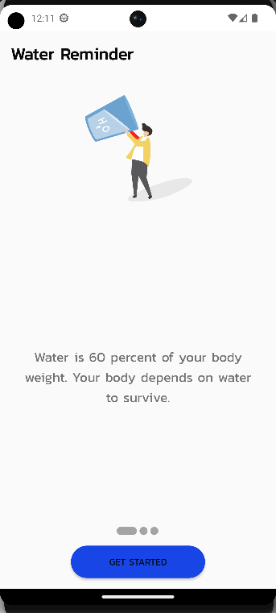
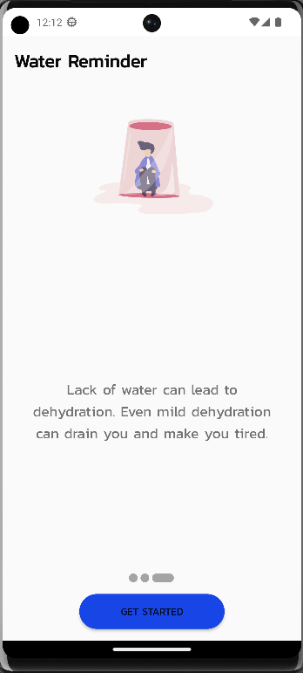
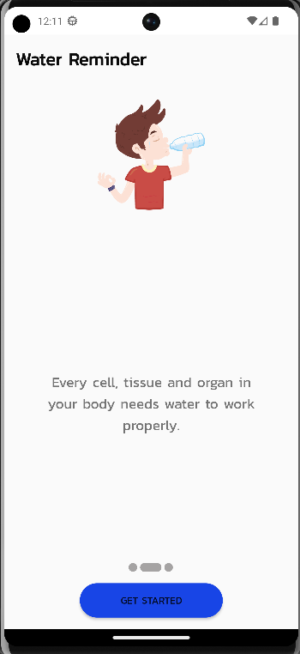
Screenshots of the Application

Slide 12
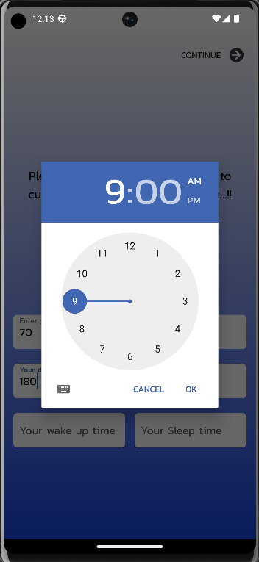
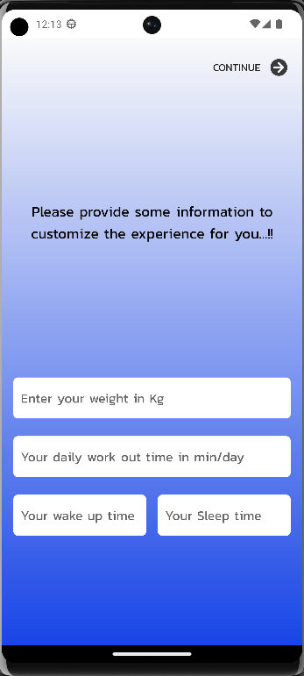
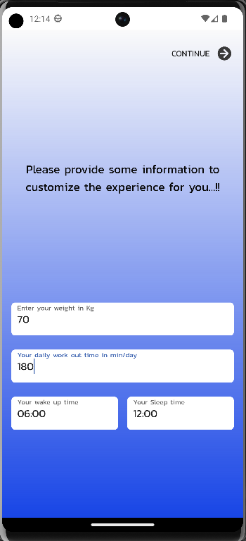
Screenshots of the Application(Continued)

Slide 13
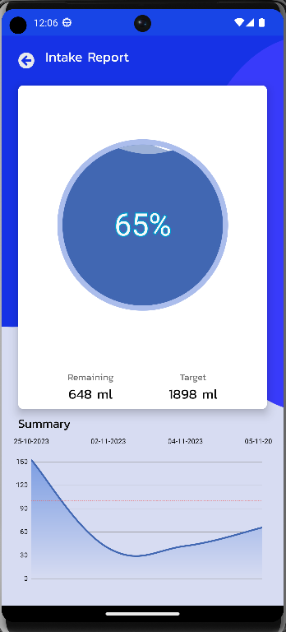
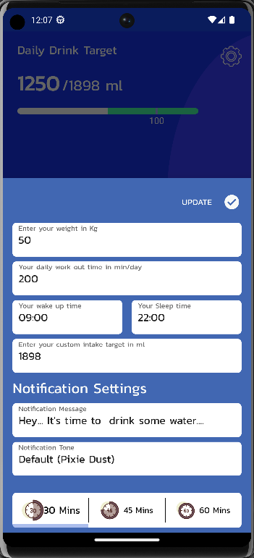
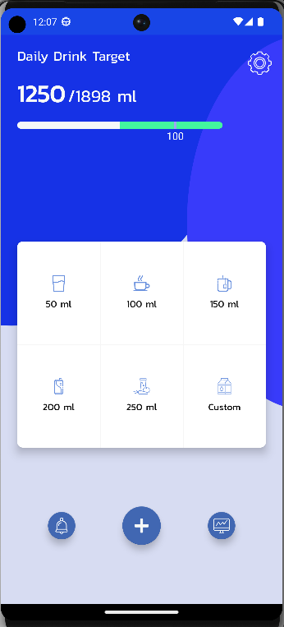
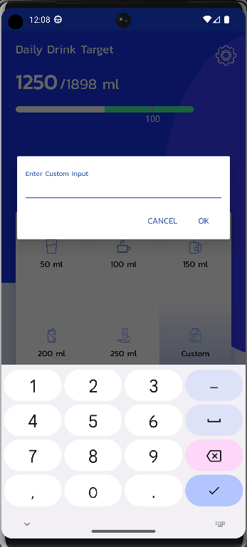
Screenshots of the Application(Continued)

Slide 14
Evaluation Process
To evaluate the app we created a Microsoft form, attached the link to the app and asked the users to answer questions based on their experience using the app.
The users have to give a rating in the range of 1-5 based on their experience.
We had a total of 14 responses.
There were 5 questions in total and the questions that were asked for the evaluation are:

Slide 15
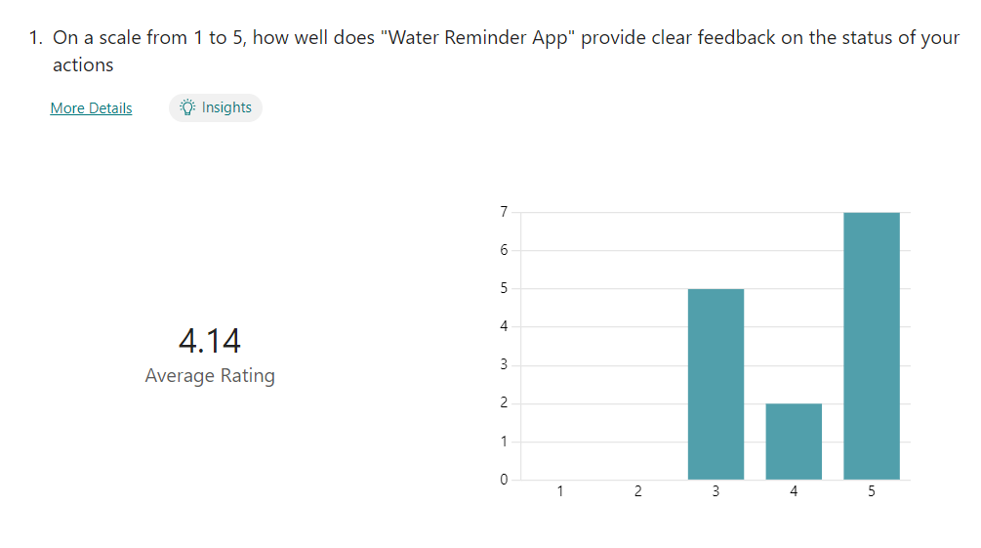
Evaluation Process (Continued)
On a scale from 1 to 5, how well does "Water Reminder App" provide clear feedback on the status of your actions?

Slide 16
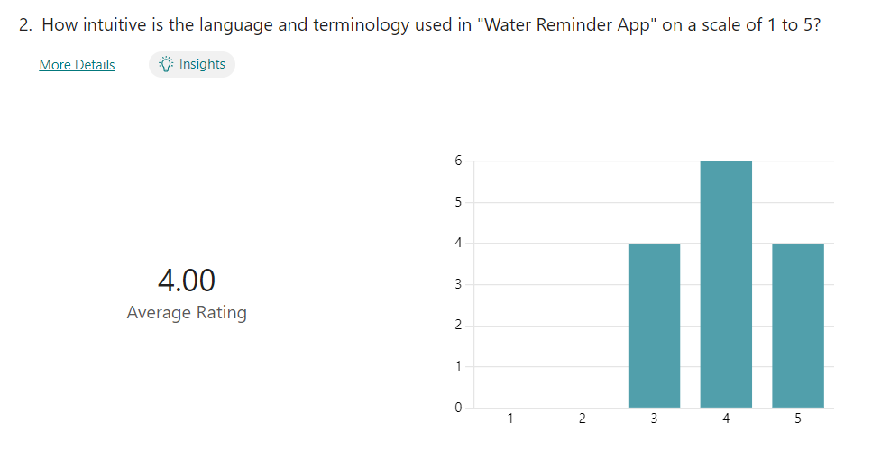
Evaluation Process (Continued)
2. How intuitive is the language and terminology used in "Water Reminder App" on a scale of 1 to 5?

Slide 17
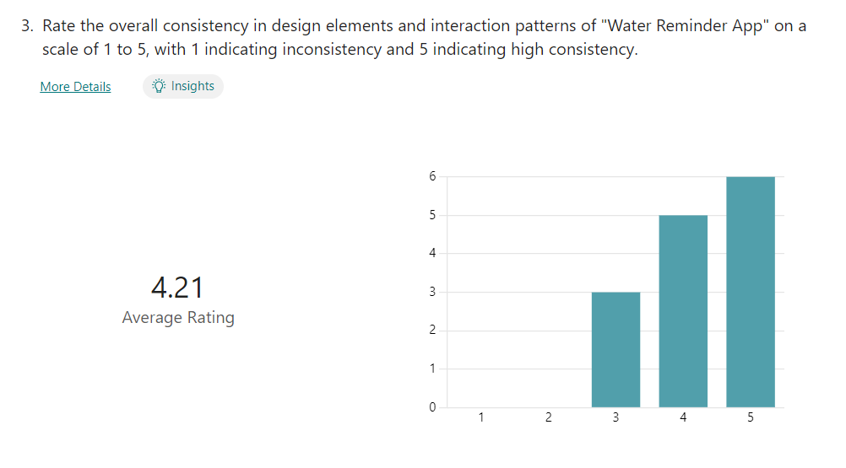
Evaluation Process (Continued)
3. Rate the overall consistency in design elements and interaction patterns of "Water Reminder App" on a scale of 1 to 5, with 1 indicating inconsistency and 5 indicating high consistency.

Slide 18
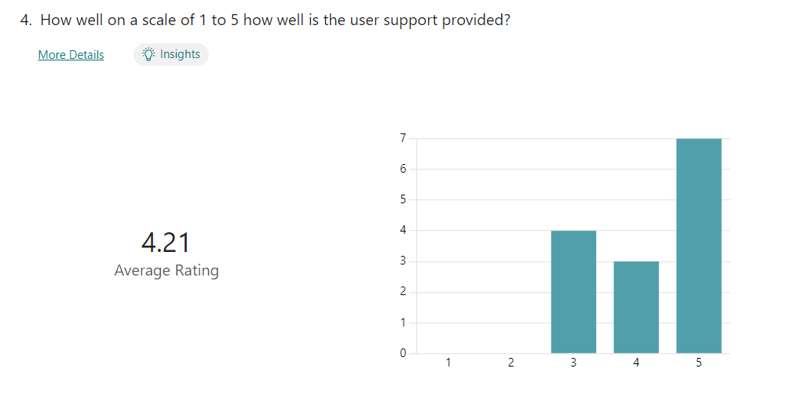
Evaluation Process (Continued)
4. How well on a scale of 1 to 5 how well is the user support provided?

Slide 19
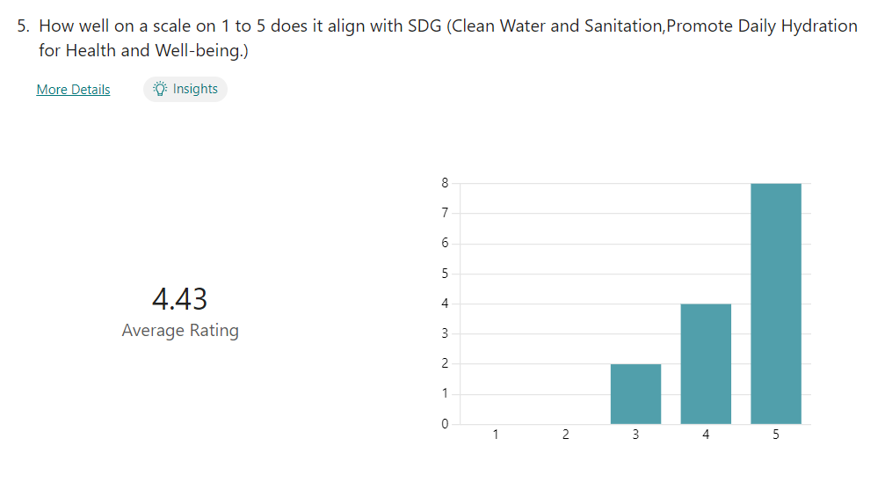
Evaluation Process (Continued)
5. How well on a scale on 1 to 5 does it align with SDG (Clean Water and Sanitation,Promote Daily Hydration for Health and Well-being.)

Slide 20
Type of user
Details of the users who tested the app are:
1. SUSHANT RAJ (200953062, sushant.raj@learner.manipal.edu)
2. SHREYANSH GOYAL (200929142, shreyansh.goyal@learner.manipal.edu)
3. AKHIL RAHMAN (200953061, akhil.rahman@learner.manipal.edu)
4. GEORGE PAULSON (200907128, george.paulson@learner.manipal.edu)
5. JALADI HARSHITH SAI (200953252, jaladi.sai@learner.manipal.edu)
6. KILLANA PRANEETH CHAND BABA (200911072, killana.baba@learner.manipal.edu)

Slide 21
Type of user(Continued)
7. RANJAN SATISH (200953202, ranjan.satish@learner.manipal.edu)
8. DIGHE PRANEET ATUL (200953057, dighe.atul@learner.manipal.edu)
9. RAUNAK KUMAR MISHRA (200953178, raunak.mishra@learner.manipal.edu)
10. SAKETH TULASI (200953138, saketh.tulasi@learner.manipal.edu)
11. JACOB SAJU (200953047, jacob.saju@learner.manipal.edu)
12. PUNEETH S (200929056, puneeth.s@learner.manipal.edu)
13. PARTH KHOKHAR (200909018, parth.khokhar@learner.manipal.edu)
14. AEKANK ANKUR PATEL (200929246, aekank.patel@learner.manipal.edu)

Slide 22
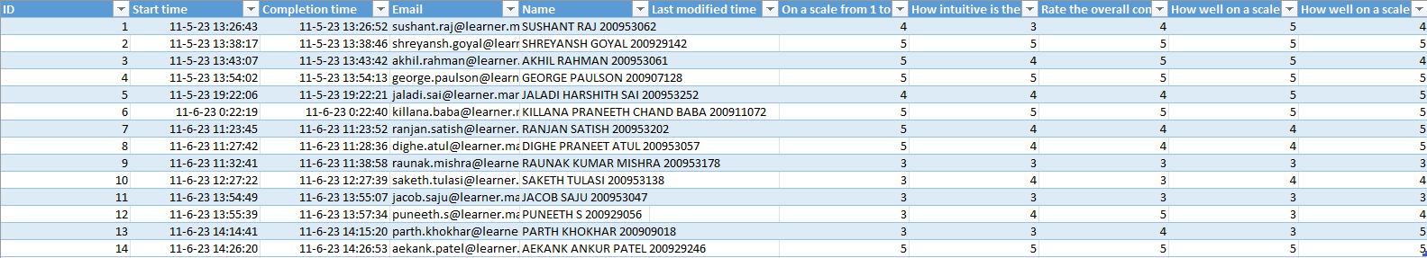
Type of user(Continued)

Slide 23
Individual contribution
Team | Reg No | Name | Branch and Section | Individual Contribution
10 | 200953014 | Suhas Srinivas Gowda | CCE-A | Helped in making the report and the app design. Also helped In getting user response for evaluation.
 | 200953025 | Vaishnavi | CCE-A | Helped in making the report and the app design. Helped in recording the video of the UI design.
 | 200953015 | Adithya Rao Kalathur | CCE-A | Helped in making the report and the app design. Helped In getting user response for evaluation. Also helped in recording the video of the UI design.

